Slide 1
Intro to Python Programming
June 07, 2020
By:
Random Python Guy

Slide 2
Audience
Beginner or no Coding knowledge

Slide 3
Table of contents
Getting started
Usages of Python
Jupyter Notebook
Keywords , Comments
Variables and Data Types

Slide 4
Getting Started
Python is an interpreted, high-level, general-purpose programming language. Created by Guido van Rossum and first released in 1991.
Most recent major version of python is Python3.
It is english like language.

Slide 5
Usages of Python
Software development (PySimpleGUI, TKinter)
Web Development (Django, Flask)
Big Data (PySpark)
Data Science/Machine Learning (SKLearn, OpenCV, etc….)
Data Analytics (Pandas, MatplotLib)
And so many …. (Mathematics, Game Development, Quick Scripting)

Slide 6
Jupyter Notebook
The Jupyter Notebook is an open-source web application that allows you to create and share documents that contain live code.
Easy to and use.

Slide 7
Comments
Single Line Comment (#)
Multi Line Comments (Python has nothing for multiline comments)
But we can write multiline comments using string literals.
Let’s see…

Slide 8
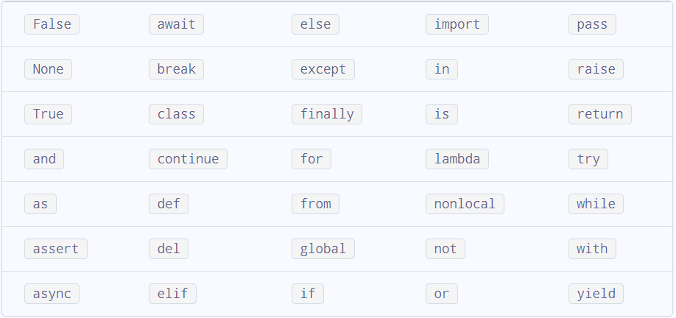
Keywords
Source: www.programiz.com

Slide 9
Variables and Data Types
Variables are containers for storing data values.
Understanding the variable concept.
Unlike other programming languages, Python has no command for declaring a variable.
A variable is created the moment you first assign a value to it.
You don’t have to give the data type in Python (Python is not statically typed).

Slide 10
Continued...
A variable name must start with a letter or the underscore character
A variable name cannot start with a number
A variable name can only contain alpha numeric characters and underscores (A-z, 0-9, and _ )
Variable names are case-sensitive (age, Age and AGE are three different variables)
Let’s Jump to Jupyter Notebook..

Slide 11
Thank You

